Slide 1
Capstone Engagement
Assessment, Analysis, and Hardening of a Vulnerable System
Prepared by
Tamim Shahriar

Slide 2
Table of Contents
This document contains the following sections:
01
Network Topology
02
Red Team: Security Assessment
03
Blue Team: Log Analysis and Attack Characterization
Hardening: Proposed Alarms and Mitigation Strategies
04

Slide 3
Network Topology
‹#›

Slide 4
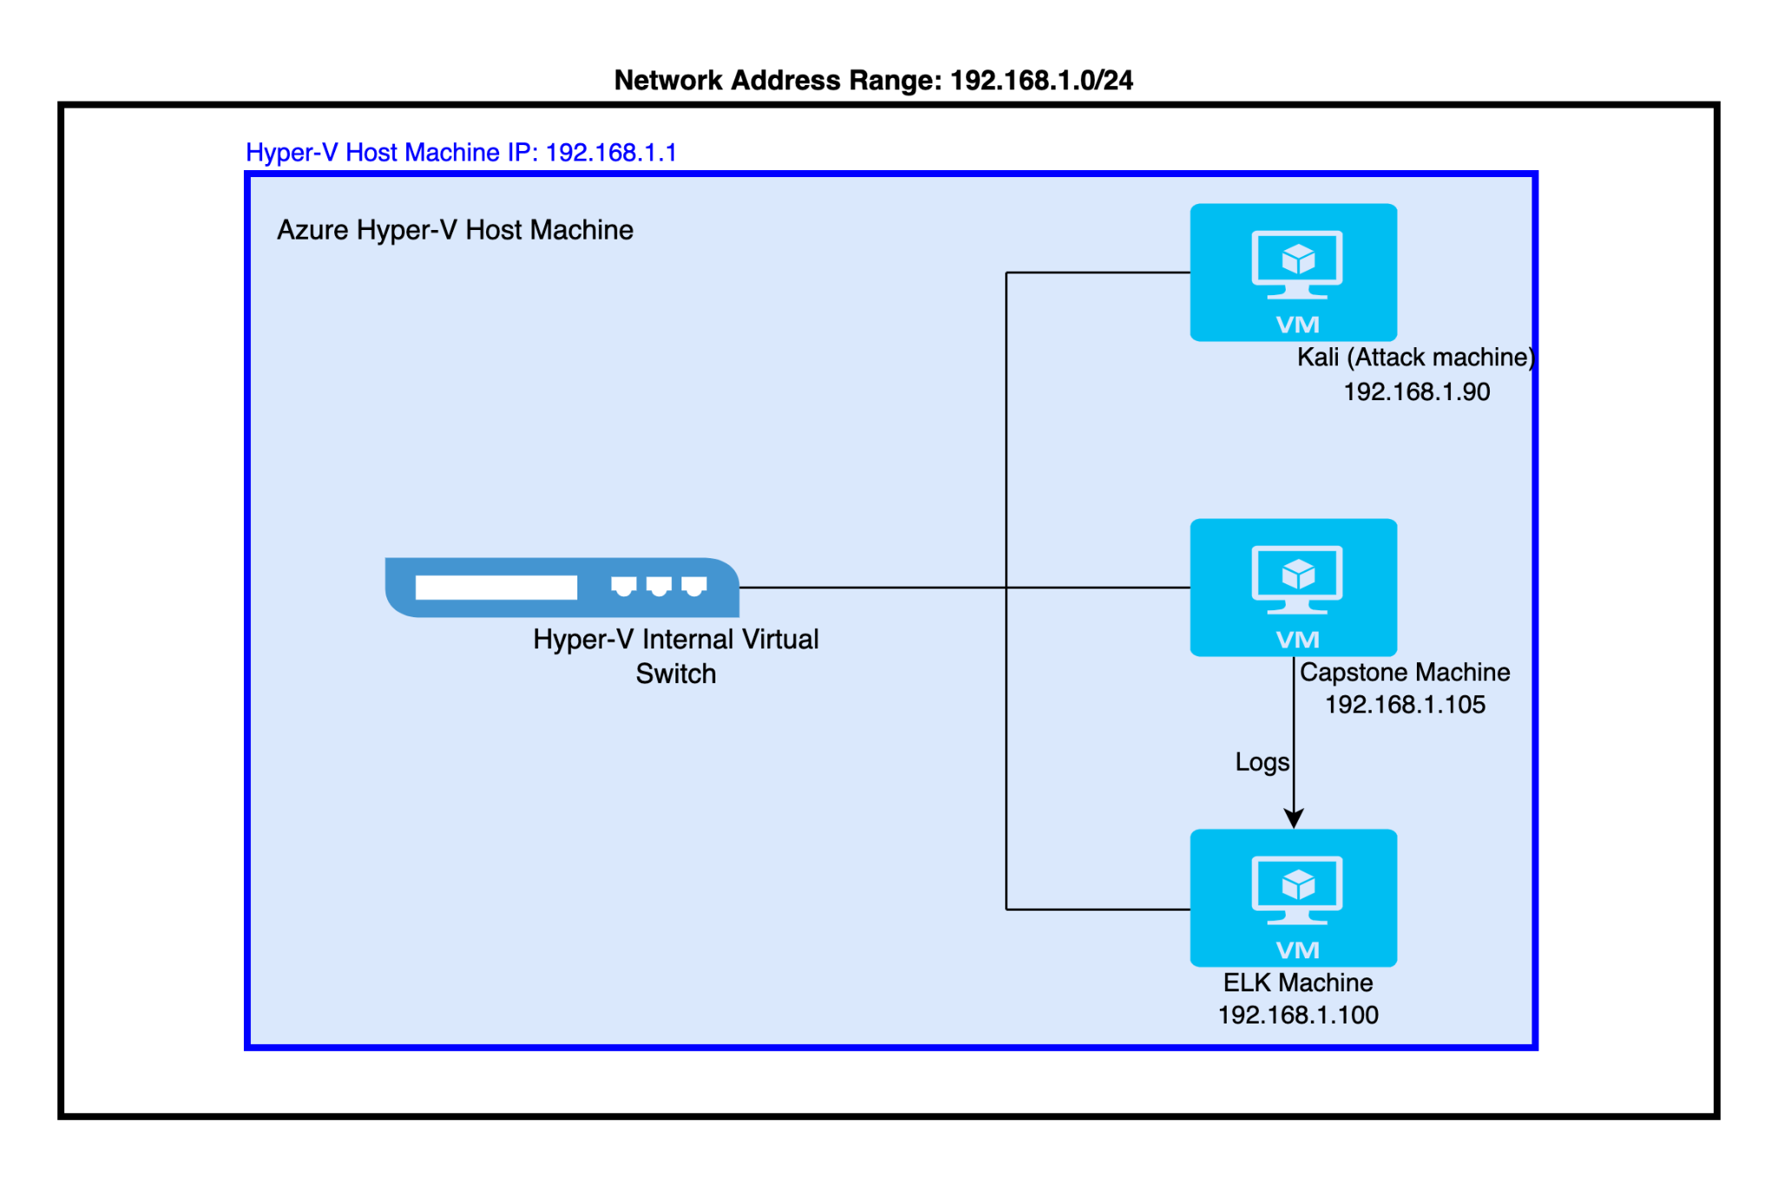
Network Topology
Network
Address Range:
192.168.1.0/24
Netmask: 255.255.255.0
Gateway: 192.168.1.1
Machines
IPv4: 192.168.1.1
OS: Windows 10 Pro
Hostname:
ML-REFVM-684427
(Azure Hyper-V)
IPv4: 192.168.1.90
OS:
Kali GNU/Linux Rolling
Hostname: Kali
IPv4: 192.168.1.100
OS: Ubuntu 18.04.4 LTS
Hostname: ELK
IPv4: 192.168.1.105
OS: Ubuntu 18.04.1 LTS
Hostname: Server1 (Capstone)

Slide 5

Red Team
Security Assessment
‹#›

Slide 6
Recon: Describing the Target
Nmap identified the following hosts on the network:
Hostname | IP Address | Role on Network
Hyper-V Host Machine | 192.168.1.1 | It hosts other virtual machines.
Kali (Attack Machine) | 192.168.1.90 | This is the attacking machine
ELK (ELK Stack Server) | 192.168.1.100 | This is network monitoring machine running Kibana
Server1 (Capstone Machine) | 192.168.1.105 | It’s the target machine which has been exploited.

Slide 7
Vulnerability Assessment
The assessment uncovered the following critical vulnerabilities in the target:
Vulnerability | Description | Impact
Sensitive Data Exposure | Sensitive data or information is publicly accessible | Attacker can access sensitive data which can be later used for exploit another vulnerability
Brute Force Vulnerability | An attacker uses a system of trial and error in an attempt to guess valid user credentials. | Through brute force attack, attacker may gain the user credentials and exploit the system.
Unauthorized File Upload | There is no restriction placed on who can upload files to the server | The attacker may upload malicious files such as reverse shells.
Remote Code Execution | Remote code execution (RCE) attacks allow an attacker to remotely execute malicious code on a computer | The impact of an RCE vulnerability can range from malware execution to an attacker gaining full control over a compromised machine.

Slide 8
Vulnerability Assessment
The assessment uncovered the following critical vulnerabilities in the target:
Vulnerability | Description | Impact
Unsalted Hashed Password | If passwords aren’t salted, it can be easily cracked using different software like John The Ripper or web tool like www.crackstation.net. | The attacker can easily cracked the password hash using online tools or software.
LFI Vulnerability | LFI allows access into confidential files on a site. | An LFI vulnerability allows attackers to gain access to sensitive credentials
Port 80 is publicly accessible | Open and unsecure access through port 80 for any anyone. | Sensitive information and data can be leaked through unrestricted access through port 80.
Webdav Vulnerability | It exploits WebDAV on a server, which could allow an attacker to run arbitrary code. | An attacker who successfully exploited this vulnerability could gain the same user rights as the current user

Slide 9
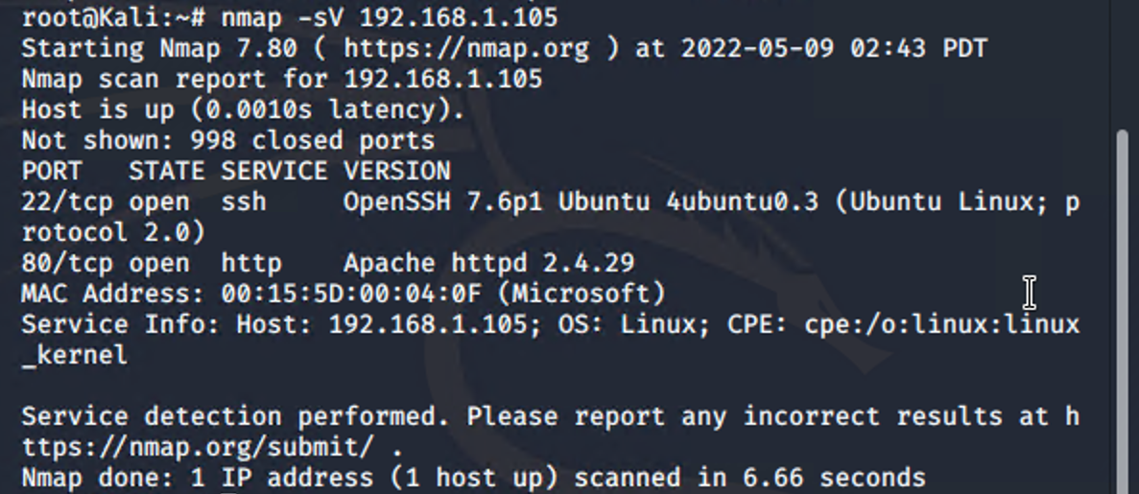
Exploitation: Port 80 Open to Public Access
01
Tools & Processes
I used command-line tool nmap to run a port scan on the target machine.
03
The screenshot of this task is presented as below:
02
Achievements
I found that it has 2 open ports such as port 80 and port 22. Also I detected the versions on which the service are running currently.

Slide 10
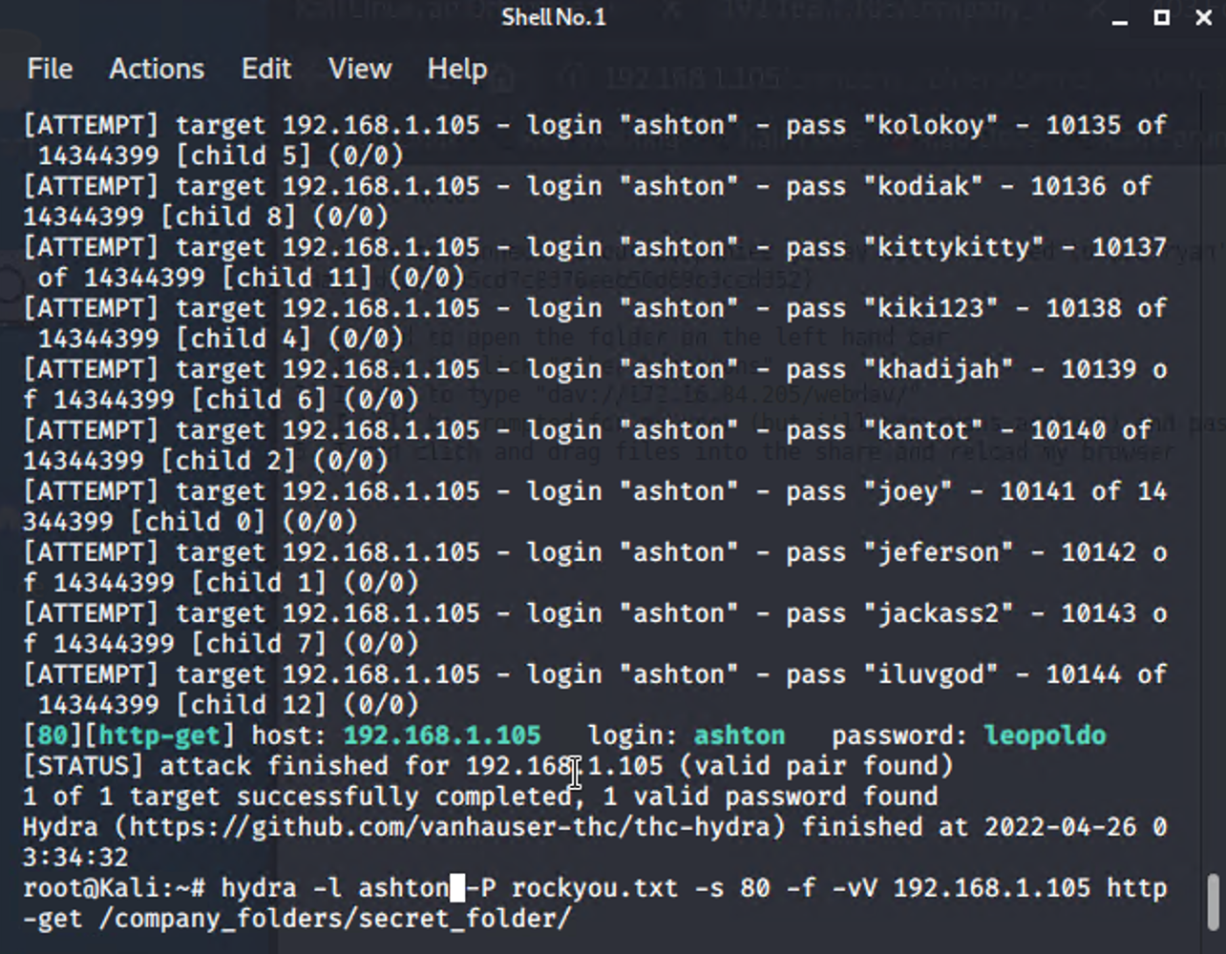
Exploitation: Brute Force Attack
01
Tools & Processes
I ran command-line tool hydra to conduct a brute force attack on the target secret directory. .
03
The screenshot of this task is presented as below:
02
Achievements
I found the login credential of one of the users. Then I used this credential to access the secret directory and found ryan’s password hash.

Slide 11
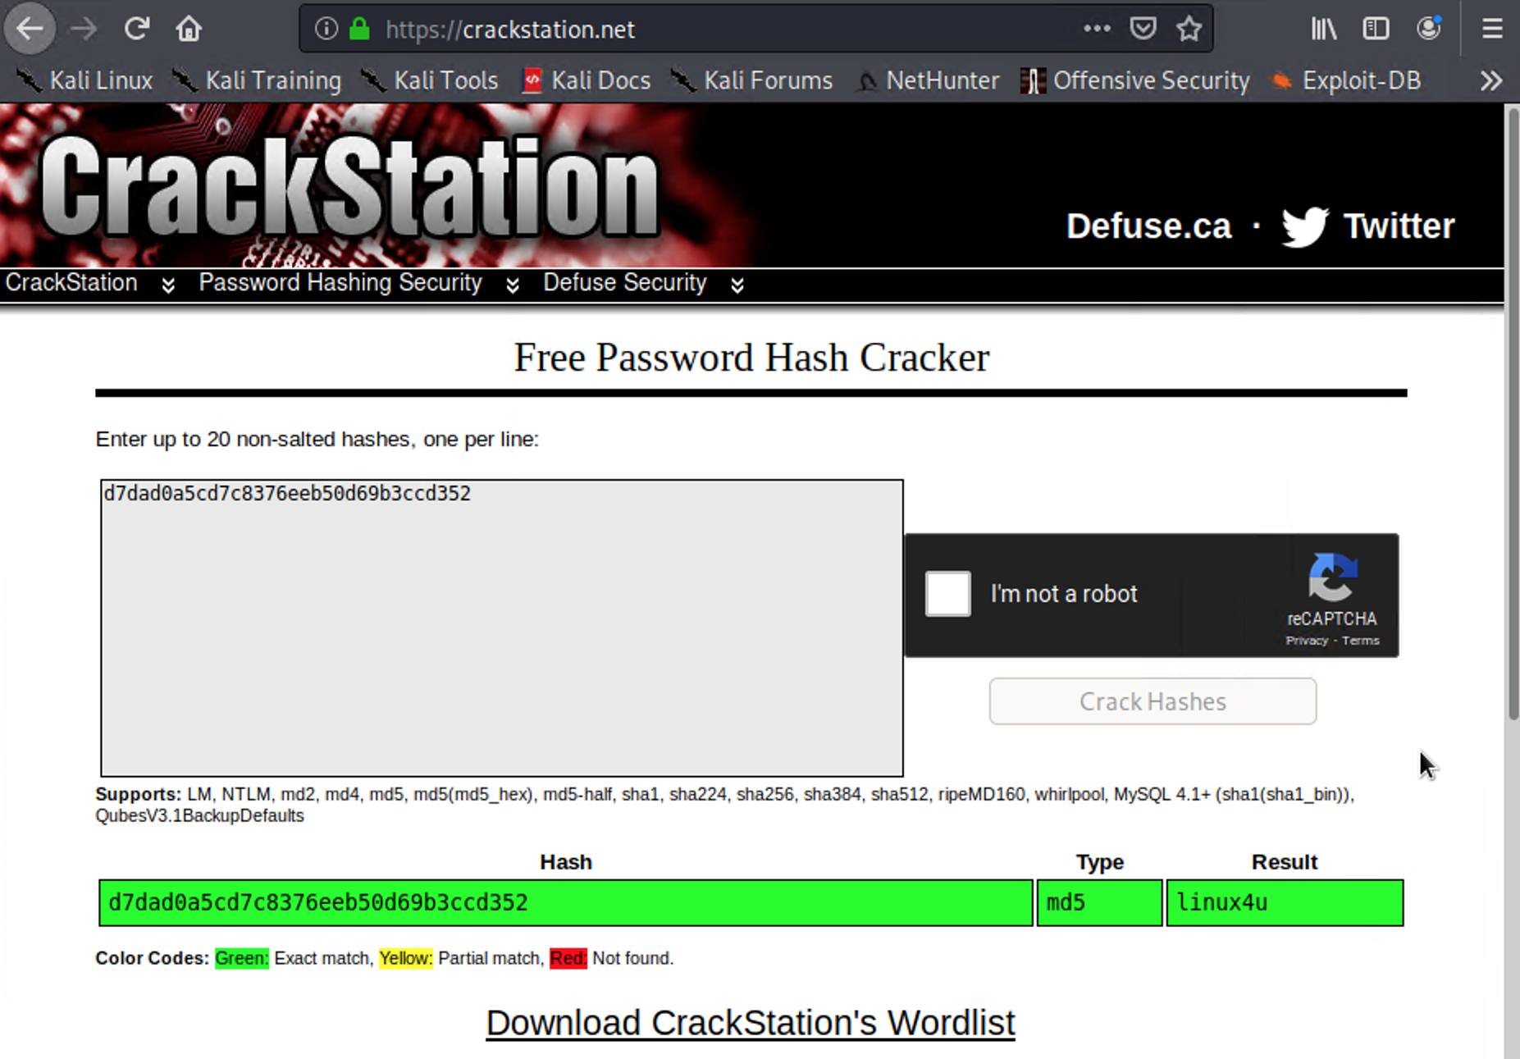
Exploitation: Cracking Password Hash
01
Tools & Processes
I used the website crackstation.net to crack the password hash.
03
The screenshot of this task is presented as below:
02
Achievements
I found ryan’s password which was used to access the companies webdav server.

Slide 12
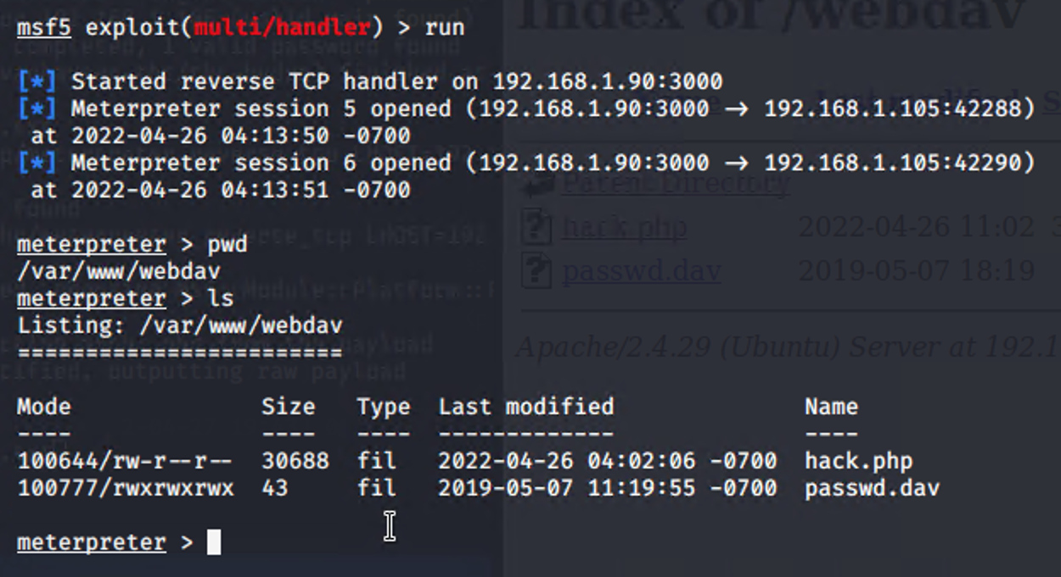
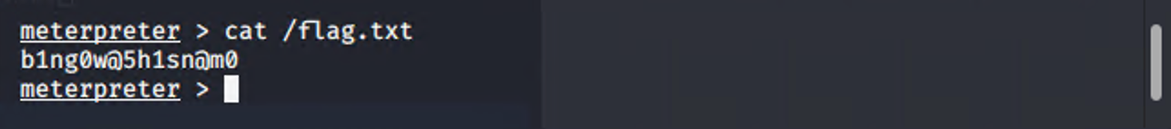
Exploitation: Local File Inclusion Attack
01
Tools & Processes
After accessing the webdav server, I uploaded a reverse shell payload which was created by msfvenom. Then I started a meterpreter session using multi/handler exploit from Metasploit tool.
03
The screenshot of this task is presented as below:
02
Achievements
Through this exploit, I was able to get the shell access on the target machine.

Slide 13

Blue Team
Log Analysis and Attack Characterization
‹#›

Slide 14
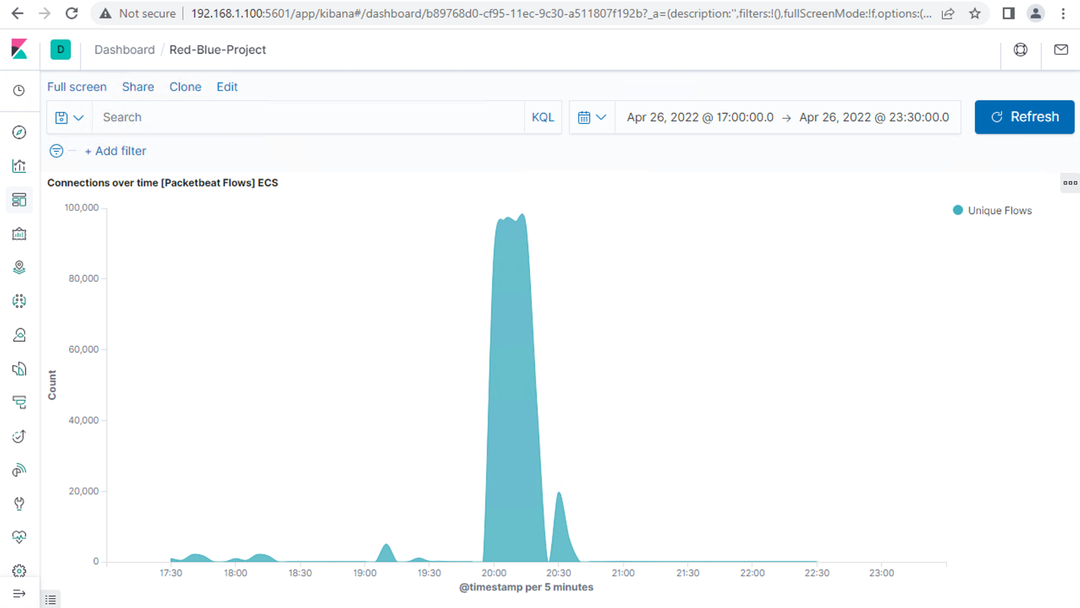
Analysis: Identifying the Port Scan
The port scan occurred between 07:55PM to 08:40PM on 26 Apr 2022.
Around 96,850 packets per 5 minutes were sent at the peak from IP address 192.168.1.90.
The sudden peak in network traffic indicates that it was a port scan.

Slide 15
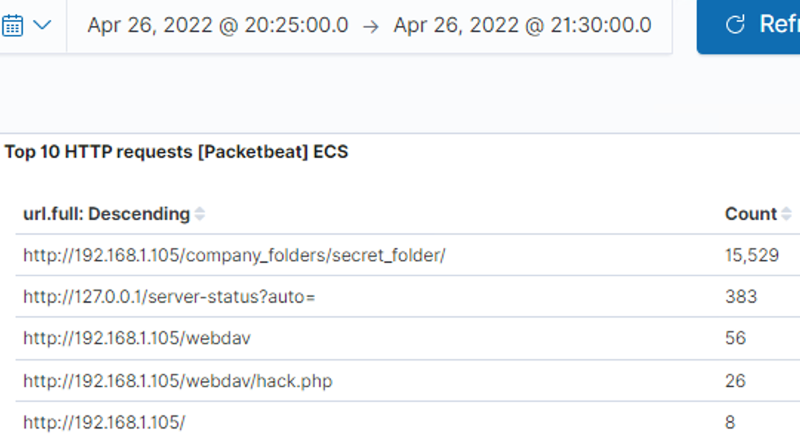
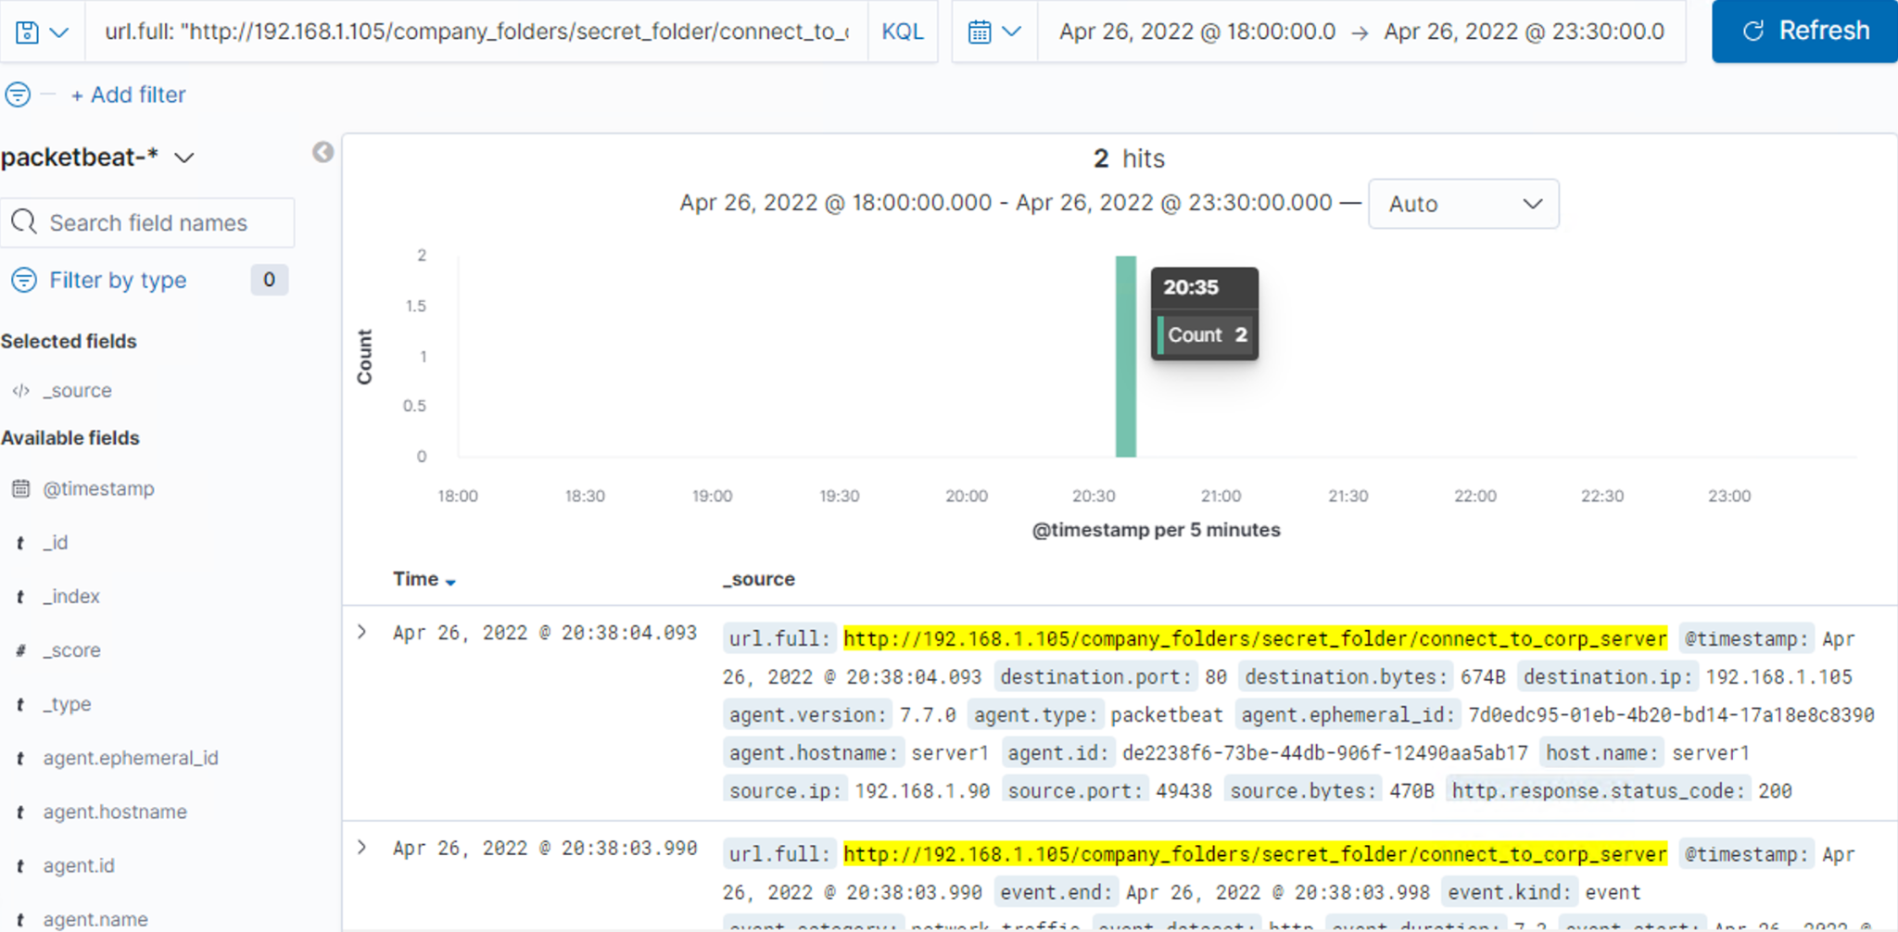
Analysis: Finding the Request for the Hidden Directory
The request occurred at around 08:30PM on 26 Apr 2022. 15,529 requests were made.
The requested file within the hidden directory was connect_to_corp_server. It contained the instructions on how to connect to webdav server. It also contained the password hash of ryan.

Slide 16
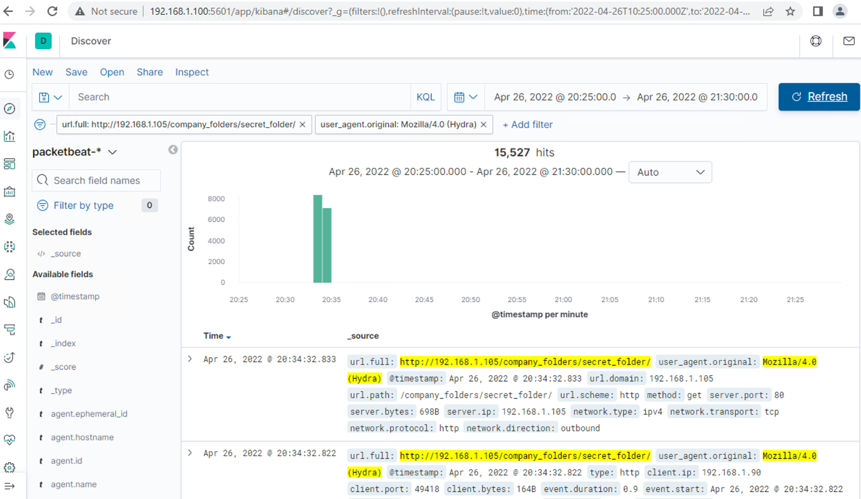
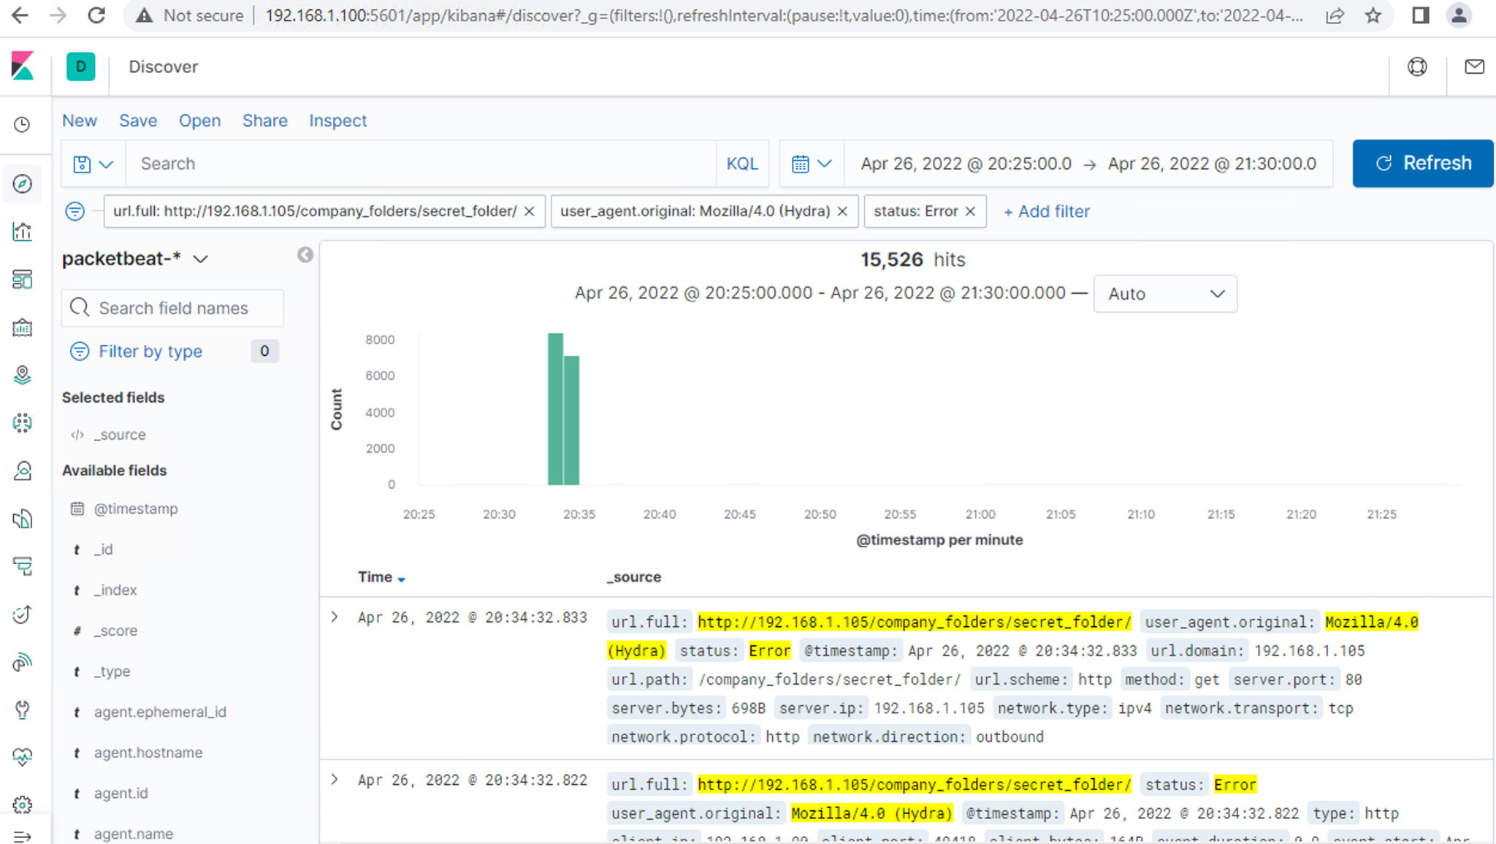
Analysis: Uncovering the Brute Force Attack
15,527 requests were made in the attack using Hydra.
15,526 requests had been made before the attacker discovered the password.

Slide 17
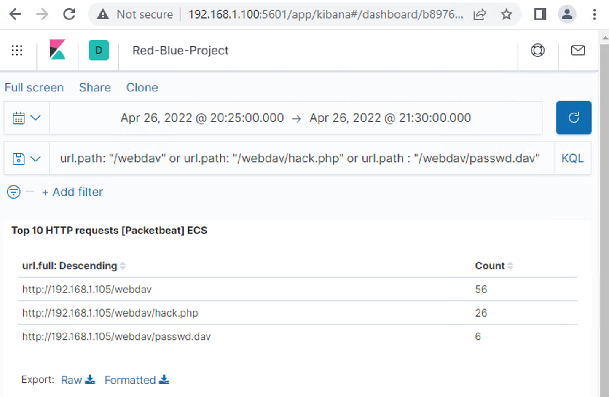
Analysis: Finding the WebDAV Connection
Total 56 requests were made to this directory.
The requested files from this directory were hack.php and passwd.dav

Slide 18
Blue Team
Proposed Alarms and Mitigation Strategies
‹#›

Slide 19
Mitigation: Blocking the Port Scan
What kind of alarm can be set to detect future port scans?
The alarm can be set that can detect the number of requests per second.
What threshold would you set to activate this alarm?
60 requests per second
What configurations can be set on the host to mitigate port scans?
Regularly run system port scan and make sure only required ports are open.
Make sure the security system can detect port scan and block any port scan attempt.
Only specific IPs could be whitelisted.

Slide 20
Mitigation: Finding the Request for the Hidden Directory
What kind of alarm can be set to detect future unauthorized access?
An alarm can be set that can detect any http request made for this directory outside of the whitelisted IPs
What threshold would you set to activate this alarm?
5 requests per second
What configuration can be set on the host to block unwanted access?
Configure in a way that only whitelisted IPs can make the request for this directory.
Trigger alarm if any request is made for this directory and immediately block the attempt to access it.
These files and folders should be encrypted.

Slide 21
Mitigation: Preventing Brute Force Attacks
What kind of alarm can be set to detect future brute force attacks?
Alarm to detect the number of unsuccessful login attempts per minute.
What threshold would you set to activate this alarm?
30 unsuccessful login attempts per minute from a same ip address
What configuration can be set on the host to block brute force attacks?
Set a policy so the user account and IPs would be locked out for 1 hour after 5 unsuccessful attempts.
Create a password policy that allow users to have only complex and hard passwords.

Slide 22
Mitigation: Detecting the WebDAV Connection
What kind of alarm can be set to detect future access to this directory?
An alarm that can detect any access attempt to the Webdav outside of the trusted IPs.
What threshold would you set to activate this alarm?
1 access attempt to Webdav per second outside of those trusted/whitelisted IPs.
What configuration can be set on the host to control access?
Whitelist only the specific IP addresses which will only should be granted access.
Trigger alarm and block any access attempts to Webdav outside of whitelisted IPs.

Slide 23
Mitigation: Identifying Reverse Shell Uploads
What kind of alarm can be set to detect future file uploads?
An alarm that can detect any attempt to upload any suspicious file extension outside of specified/whitelisted file extensions.
What threshold would you set to activate this alarm?
1 attempt to upload files outside of whitelisted file extensions
What configuration can be set on the host to block file uploads?
Give Read Only permission to the user where possible. Set full permission to only specific users only where necessary.
Regularly check the open port and make sure that only necessary ports are open.
Allow only specific file extensions to be uploaded.

